Slide 1
EDA CASE STUDY
SUBMITTED BY: AMREESH KUMAR
VIKAS KUMAR

Slide 2
INTRIDUCTION
It is a basically loan dataset where as people had taken the loan and we shall to analyze which people eligible for the loan and which is defaulter list(which is already taken a loan but not repay) and how many people currently repaying the loan.
GOAL :
Our main goal to analyze and plot the dataset which peoples in defaulter list and which one is currently active to repaying the loan and which one the not repaying the loan amount after taking.

Slide 3
Step-1
Firstly, we seen the dataset and analyze which column important and which is not . There are 39717 rows and 111 column in this dataset after analyzing, The columns which are important for our target Loan status are [loan amount , annual income, interest rate, term, purpose, home ownership , grade, sub grade , employment length, issueMonth].

Slide 4
Step-2
After analyzing we performed the cleaning of the dataset(for remove the null value). we did remove the columns which have greater than 30000 null value after that we removed the unnecessary columns(emp_title, desc, mths_since_last_delinq ) and also rows.

Slide 5
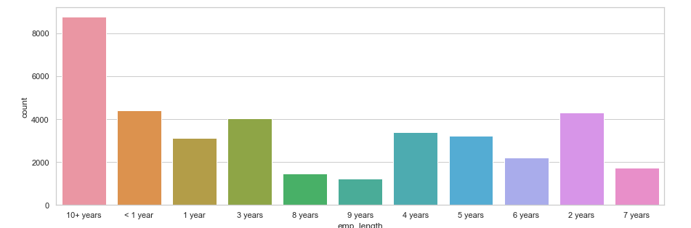
Visualization of emp_length

Slide 6
Step-3
Filling all Null values on the basis of their respective columns( like emp_length, last_pymnt_d, collections_12_mths_ex_med, pub_rec_bankruptcies etc.)

Slide 7
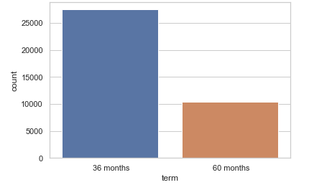
Step-4
we did plot the term (duration of the loan) which defines the which peoples taken the loan for 36 months or 60 months and how much amount. Same as purpose(which type of loan taken like credit card ,car, small business

Slide 8
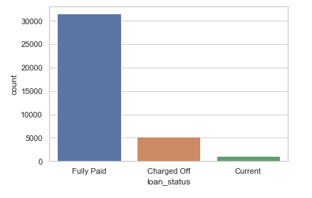
Step-5
We did plot the loan status.
After that analyze the derived matrics on the clumns(issue_d,issueMonth and issueDay)

Slide 9
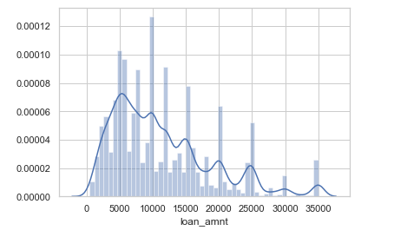
Step-6
After completed derived matrics we did analyze and plot the univariate analysis on the loan_amnt which is display the loan strategy.

Slide 10
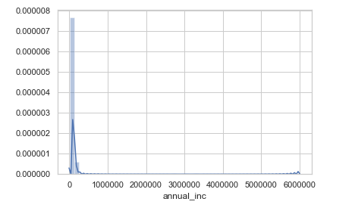
Step-7
Here in this distribution we find that most of the loan amount range are from 5k to 1 million rupees

Slide 11
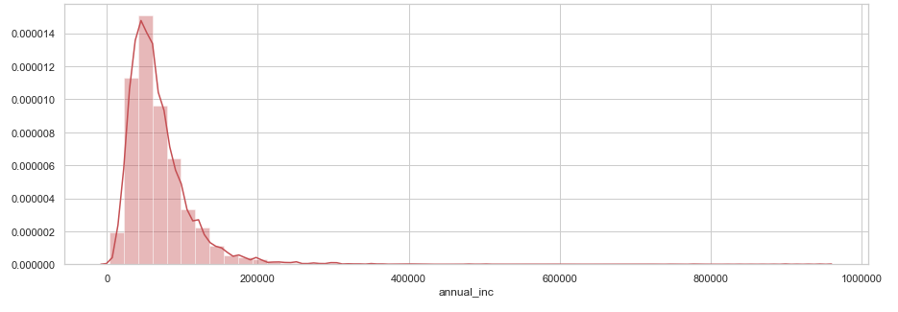
Step-8
In the distribution of annual income most people have salary less than 1 million per annum very few have salary greater then 1 million so we remove those columns which are greater than 1 million and plot again

Slide 12
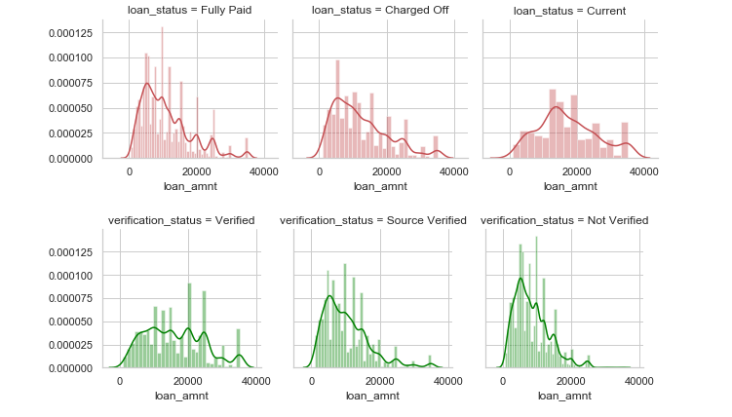
Step-9
After that we did plot the distribution of loan amount in each category of loan status and in next column with verification status respectively.

Slide 13
Step-10
we observe that people with high risk (g grade) are much found whose salary range below 2 lakh per annum rupees.
Most loan taken for the purpose of debt_consolidation and most of them are already paid.
we ploted the distribution of interest rate and found that most of the interest rate founded between 10 to 15 percent after that we analyze that the loan amount with respect to grade and found that people have f grade are taken more loan amount in which most of them are in current state.

Slide 14
Continue…
Again we ploted the loan amount with respect to employment length and found that people have more than 10 years work are taken more loan amount in which most of them are in current state.
After analyzing loan amount and annual income with respect to homeownership found that people who live in MORTGAGE have high annual income as well as high loan amount taken.
Then we find co relation between loan amount and annual income and observe that people whose salary below 2 lakhs are taken more loan.

Slide 15
Continue…
After completed above part then Here we drop some un necessary columns which are not good for our target column loan_status(delinq_amnt,pub_rec_bankruptcies etc.) then again we find out the correlation between columns and remove those columns which have less correalation.
As we see that Loan_amnt and the funded amount and funded amount Investment are approx same co-relation so we can remove two extra columns.

Slide 16
Continue…
we trying to find out the distribution of loan amount on the basis of home ownership and found who lives in Rent are taken loan amount very less.
The loan amount with respect to purpose of loan and found small business purpose loan are more distributed in a wide range and find correlation of columns through heatmap.
We observe that G grade has 30 percent chances to get as defaulter and more than 10 years employment length has 14 percent chances to get as defaulter.

Slide 17
Continue..
Also observe that G grade and in G1 sub-grade has more than 40 percent chances to get as defaulter and home ownership category in which who are in other has 19 percent chances to get as defaulter.
Who are taking loan for small business has more than 25 percent chances to get as defaulter and taking loan for 60 term has more than 20 percent chances to get as defaulter

Slide 18
CONCLUSION :
our target is whether the borrower pay the loan amount or he will become defaulter we focus on column LOAN_STATUS which have three category
Fully paid , charged OFF and current
OUR MAIN FEATURES :
The columns which are important for our target Loan status are [loan amount , annual income, interest rate , term, purpose , home ownership, grade , sub grade , employment length , issueMonth]

Slide 19
THANK YOU !!!!!

